Slide 1
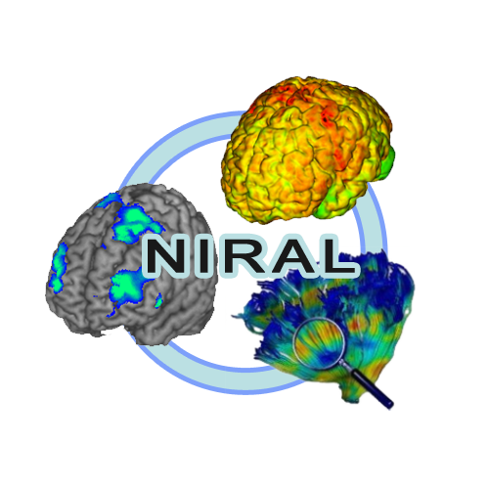




Deep Neural Networks for MS Lesion Segmentation
Presented by: Juan Carlos Prieto
Collaborators: Michele Cavallari, Miklos Palotai, Alfredo Morales Pinzon, Svetlana Egorova, Martin Styner and Charles Guttmann

Slide 2
Objectives
Improve existing segmentation algorithms for MS.
There are well established semi-automated methods to measure lesion volume.
Most of them require human interaction and editing, which is time consuming
Explore Neural Networks for MS Lesion Segmentation.
Take advantage of the large number of samples available.

Slide 3
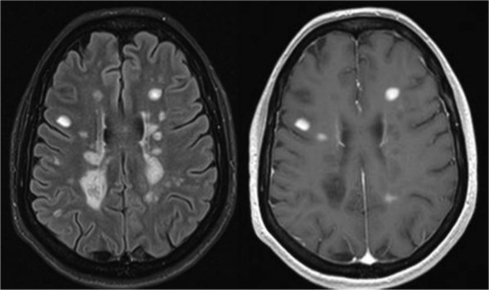
Introduction – Multiple Sclerosis (MS)
Immune-mediated process
Affects the central nervous system (CNS),
Brain, spinal cord and optic nerves.
Destruction of myelin, nerve fibers.
Unknown antigen.
The damaged myelin forms scar tissue (sclerosis).
Nerve impulses are disrupted.
Common diseases phases
Relapsing remitting (RR)
Secondary Progressive (SP)

Slide 4
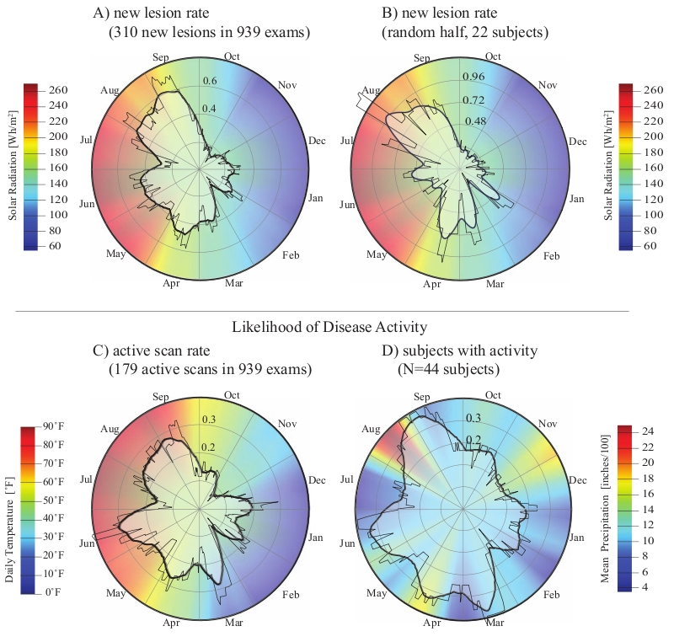
Introduction
Triggered by environmental factors
Symptoms cannot be predicted.
Diagnosis between 20 – 50 years
Women:men 3:1 ratio diagnosis
Seasonal prevalence of MS (2010)– Meier et. al.

Slide 5

Subjects
CLIMB
Comprehensive Longitudinal Investigation of Multiple Sclerosis at Brigham and Women’s Hospital
Annual clinical and laboratory examinations.
2000 MS patients
Data
Neurological examinations
MRI imaging
Immunologic
Genetic
Neuropsychological,
Quality of life studies over the next twenty years.

Slide 6
MRI Acquisition
Brain MRI
1.5T scanner (GE Signa, Milwaukee, WI).
Axial T1-weighted spin-echo (TR/TE: 725/20 ms)
Dual-echo T2-weighted (TR/TE2/ TE1: 3000/80/30 ms) series (voxel size 0.94 9 0.94 9 3 mm)
Sagittal 3D MP-RAGE sequence (TR/TE: 8.6/3.8 ms) with a voxel size of 0.94 9 0.94 9 1.2 mm.
T1-weighted spin-echo imaging was repeated 5 min after 0.1 mol/kg intravenous gadolinium (Gd).

Slide 7
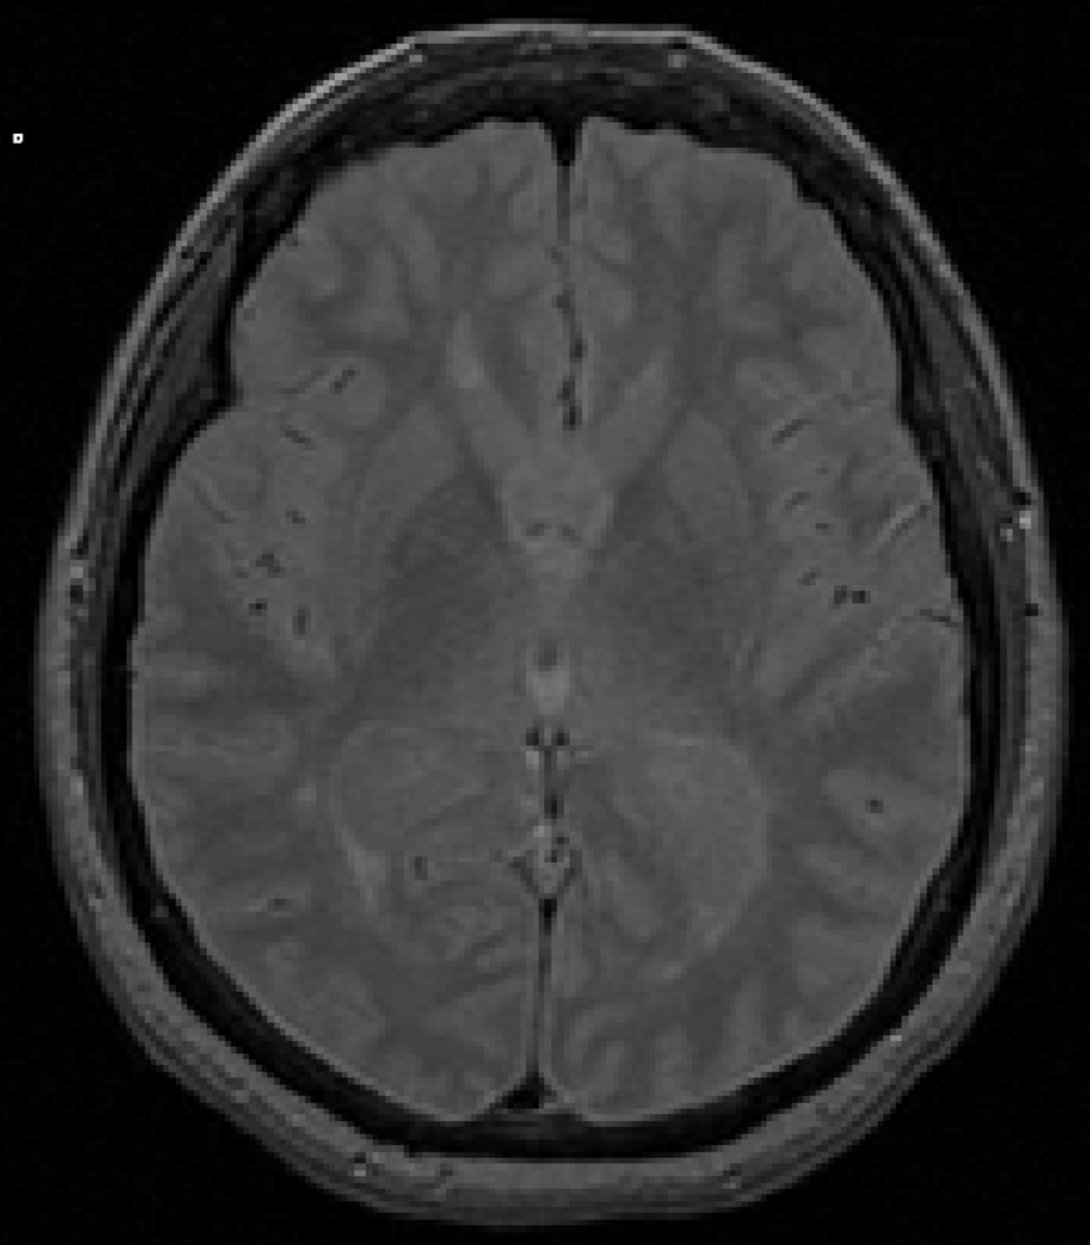
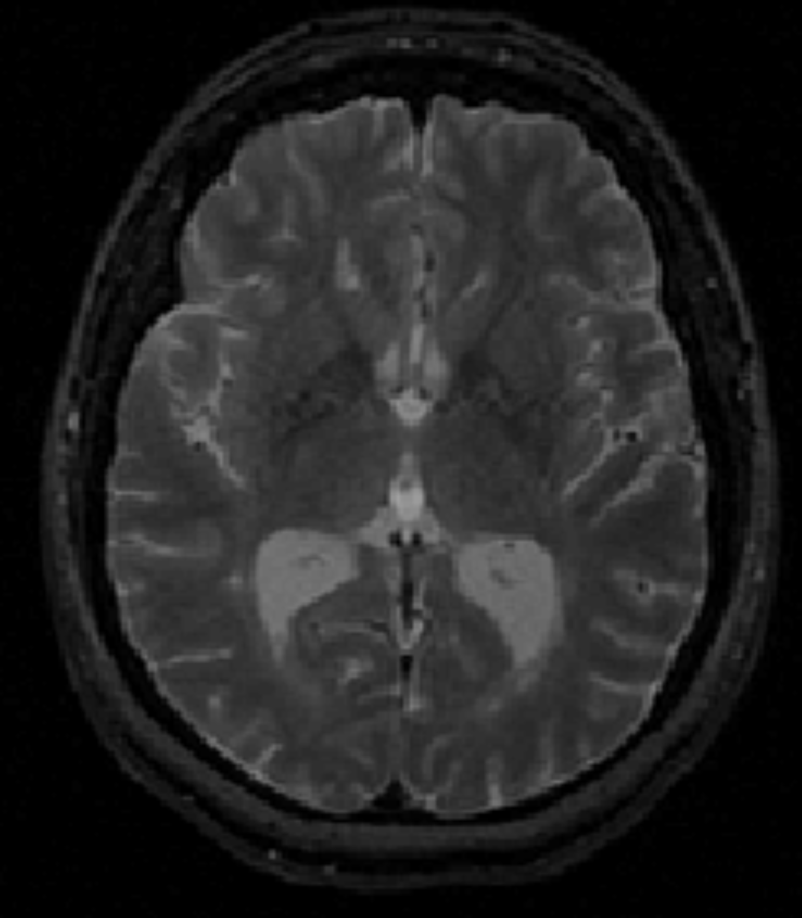
MRI analysis: lesions
T1 hypointense (T1LV)
“Black holes”
Hyperintensity on the dual- echo images
No gadolinium-enhancement
T2 hyperintense lesion volume (T2LV)
Hyperintensity on both the proton density and late echo T2-weighted images.

Slide 8



Deep Neural Networks
Set of algorithms modeled after the human brain
Designed to recognize complex patterns in the data.
Automatic feature extraction.
“Brute force” AI – Start with a blank state and hammer your way through an accurate model.

Slide 9
Neural Network Components
Convolution layer
Filter or kernel convolved with input.
Fully connected layer
Weights – connects all neurons in previous layer
Pooling
Subsampling
Rectified linear unit (RELU)
Activation function (vanishing gradient)
Dropout
Cuts flow of data (data redundancy)
Softmax
Generates probabilities.
http://deeplearning.stanford.edu/wiki/images/6/6c/Convolution_schematic.gif

Slide 10
Class imbalance problem
MS lesions are surrounded by the white matter
Number of WM samples is much larger than MS
The classes are not represented equally.
This is an imbalanced dataset
Improve sampling or reduce the search space

Slide 11
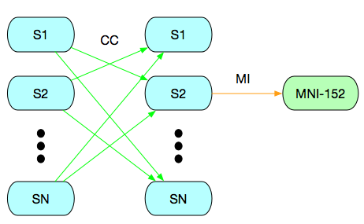
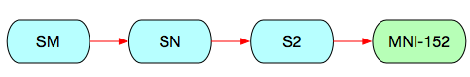
PD/T2 Image templates
20 Subjects chosen randomly.
Every subject is registered to each other.
Total 400 tranformations
One subject is registered to the MNI-152 template.
Average all images

Slide 12
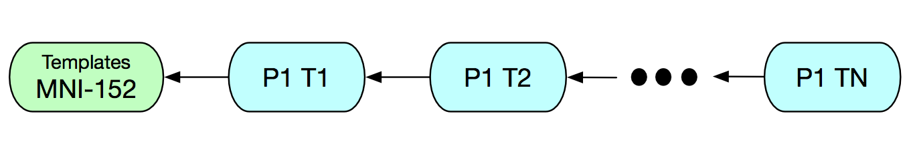
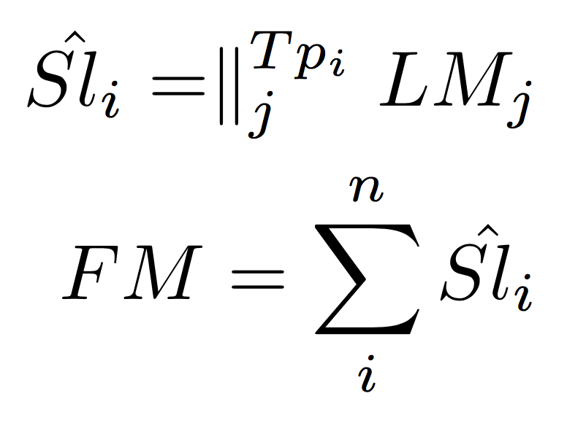
Frequency map generation
Each time point is registered to the previous one.
The first time point is registered to the templates.
All images are transformed to MNI-152 space.

Slide 13
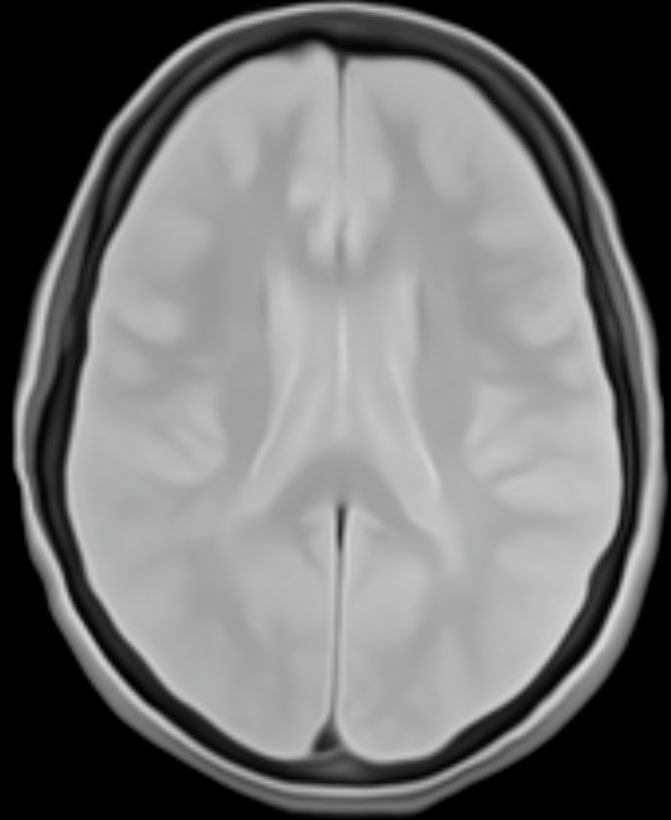
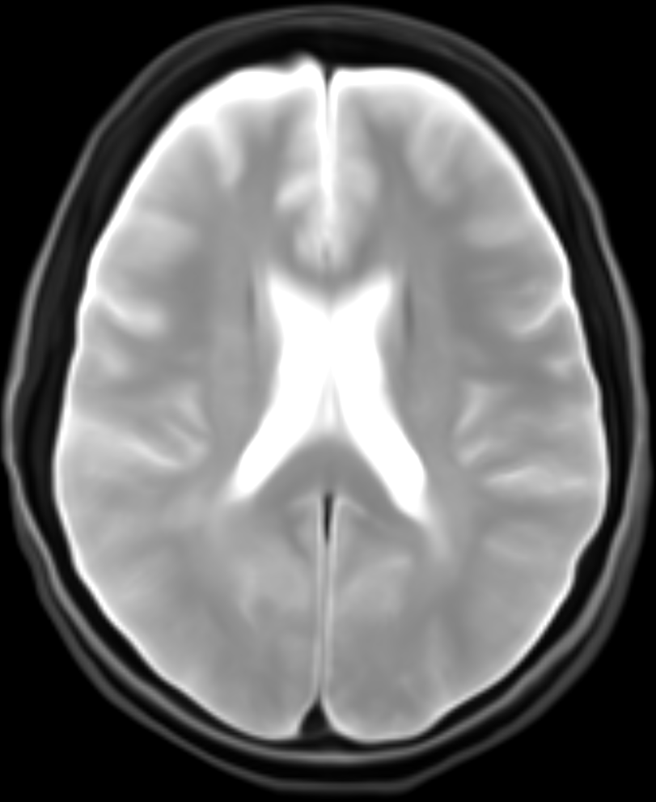
Results - Templates
Generated templates in MNI 152 atlas space. 1mmX1mmX1mm

Slide 14
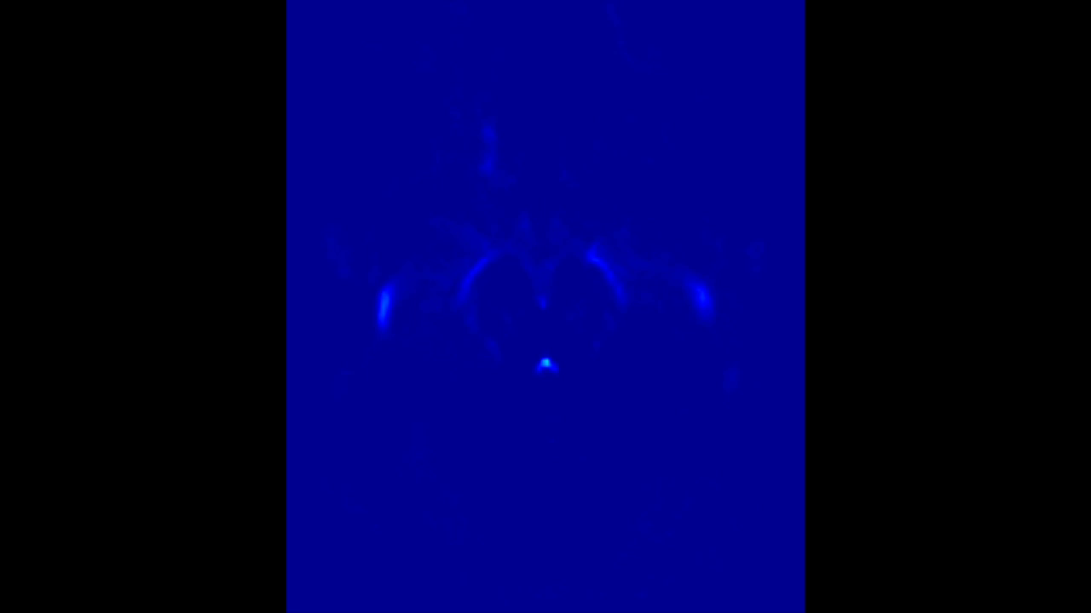
Results – Frequency map

Slide 15


MS and WM samples
1500 subjects are selected to draw samples
The number of time points varies between 1 – 8
We iterate the image randomly and select WM and MS samples
The FM is used to constrain the search region.
MS sample
WM sample

Slide 16
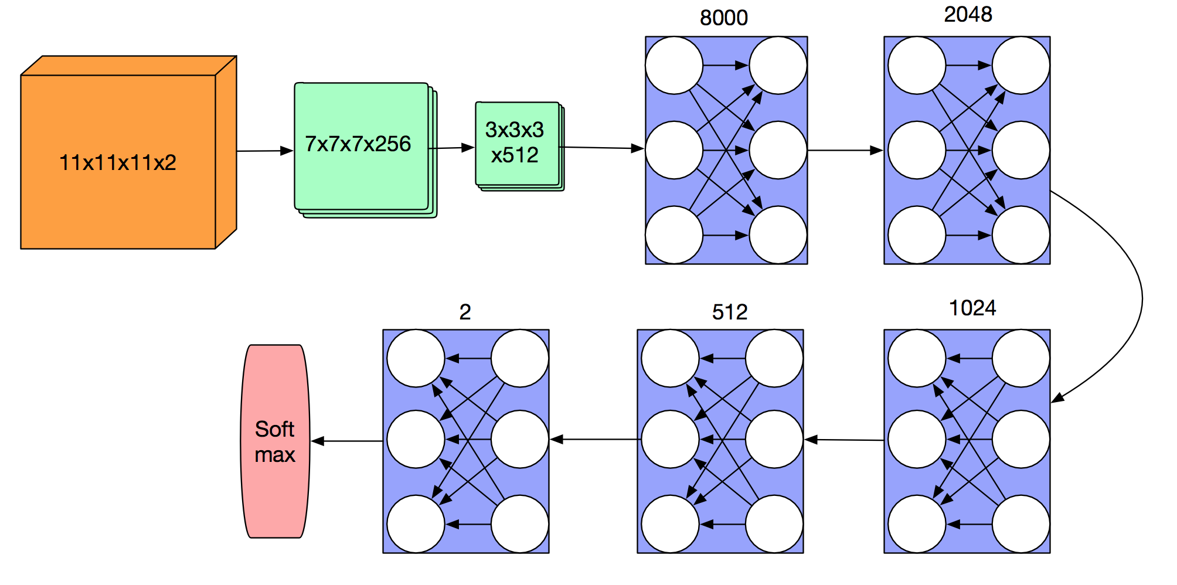
Results – Network architecture
FC
FC
Conv
Conv
Score class
FC
FC
The output of each layer is connected to a RELU function

Slide 17
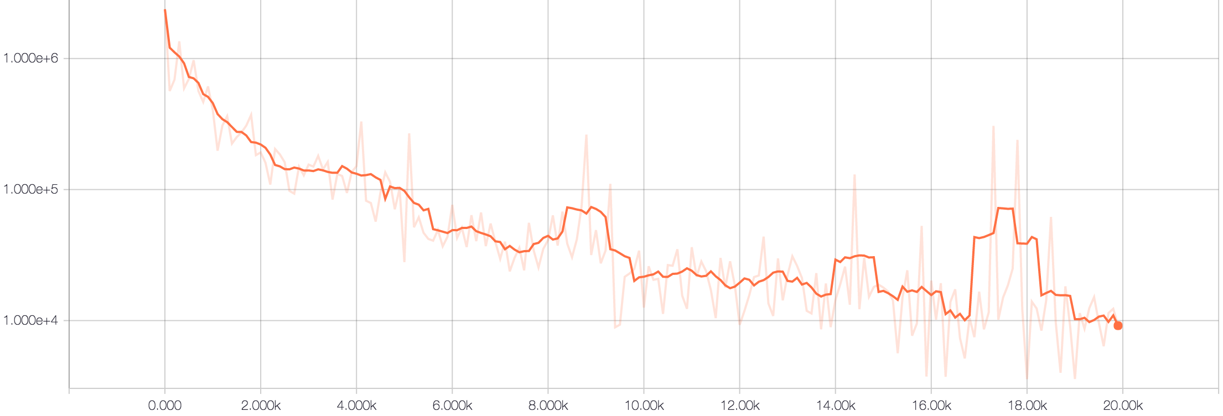
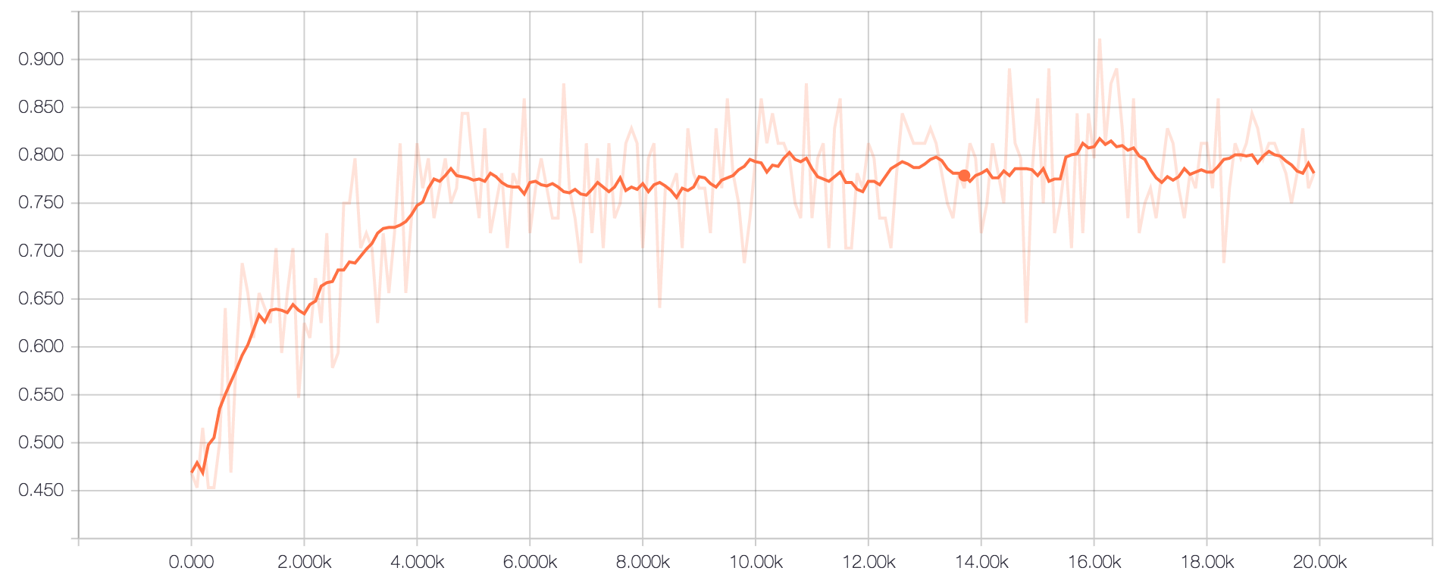
Results – Loss and accuracy

Slide 18
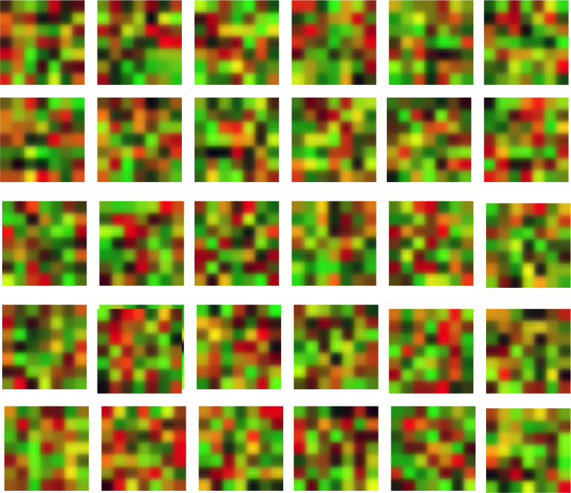
Some filters computed for the first conv layer

Slide 19
Conclusions and future work
Using the validation and test dataset, this current implementation achieved:
Validation dataset: Average accuracy = 0.846
Test dataset: Average accuracy = 0.849
The number of samples for each one is 40367.
Future work will be to compare the classification power of this algorithm compared with state of the art methods for MS lesion classification.

Slide 20
Acknowledgements
J.C. Prieto and M. Cavallari are supported by Research Fellowship Award from Mallinckrodt Pharmaceuticals.
We gratefully acknowledge the support of NVIDIA Corporation with the donation of the Tesla K40 GPU used for this research.

